Slide 1
Walsh College Open Source Community GIT Presentation
Tom Pletzke

Slide 2
Topics For Today
What is GIT
GIT on the job
GIT for home use
Using GIT (Examples and Demo)
GIT for Walsh Open Source Community
GIT Summary
Questions

Slide 3
What Is GIT
Git is a free, powerful Source Code Management tool created for Linux kernel development
Every Git working directory is a full-fledged repository with complete history and full revision tracking capabilities, not dependent on network access or a central server

Slide 4
The Basic Picture of GIT
GIT
Master
Repository
GIT
Programmer
Analyst
GIT
Production
Application
GIT
Staging
Server
GIT
Programmer
Analyst

Slide 5
GIT On The Job
Every developer has GIT installed
Automates the merging of program code, stored procedures, and views
Coordinates programs and database objects (views, stored procedures, tables) to keep them in sync
Less likely to loose enhancements during comparisons

Slide 6
GIT For Home
GIT can backup some of your files or directories to a separate drive (MyBook).
GIT will keep versions of your files on the separate drive
Setup a master bare repository on your backup / separate drive
Sync to your repository as many times as you like and GIT will keep track which files have changed
Date driven so you can go back in time
Not recommended as a full disk backup

Slide 7

How To Get GIT
GIT on Windows
  http://code.google.com/p/msysgit/
  Installs with a small Linux shell
GIT on Linux
  apt-get install git-core

Slide 8
Getting Started With GIT
“Git With It”
Creating a bare repository (the mother ship)
Creating a working directory
Setting your name and email
Send your first file
Creating a second working directory
Pulling down the repository to your second repository (Clone)

Slide 9
Updating Your Changes
“GIT Err Done”
Modify your files
Git status
Git add
Git commit
Git pull --rebase
Git push

Slide 10
How To Handle A Merge Conflict
Don’t panic
Happens when you are pulling code from the repository
Edit the file or files that are in conflict
Git add filename
Git --rebase continue

Slide 11
Working with GIT
Git log
Git log with parameters and how we used it on the job
Git blame with and without gui
Git status
Git diff

Slide 12
How Walsh Open Source Community Can Use GIT
We may have multiple people editing the websites at the same time or same week
We will have multiple web sites
Repositories create a natural backup
Master repository location
  Walsh Server
  GITHUB

Slide 13

GITHUB
Github is a web-based hosting service for projects that use the Git revision control system
Github help
  http://github.com/guides/home
  http://help.github.com/

Slide 14
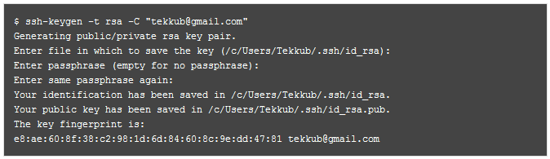
Getting Started With GITHUB
Creating a ssh key
You will need to locate your generated key
  Windows 7 stores the key /users/username/.ssh

Slide 15

Working With GITHUB
Create a Github account
  Paste your ssh key
  You can have multiple keys
Test your connection to Github

Slide 16
Using GITHUB
Create a working directory
Set your username and email
Clone your repository
  Git clone git@github.com:hiddenpawn/walsh.git .
Files are now available in the directory
Change examples (play in Github)

Slide 17
GIT Summary
What is GIT about
How GIT is used in a development environment at work
How GIT can be used at home
Examples of using GIT
How we can use GIT for our open source projects

Slide 18
Walsh College Open Source Community GIT Presentation
Questions?
Tom Pletzke

